Slide 1
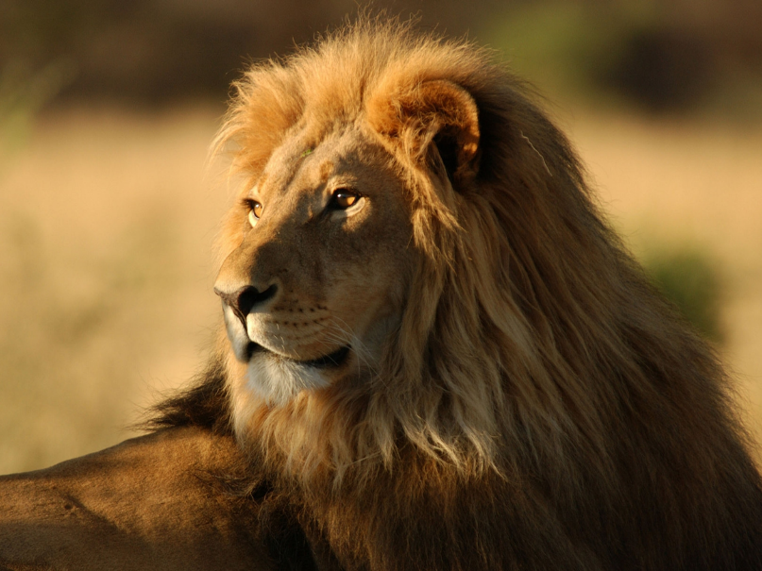



Slide 2


WHO WE ARE
Born Free’s mission is to ensure that all wild animals, whether living in captivity or in the wild, are treated with compassion and respect and are able to live their lives according to their needs.
Born Free opposes the exploitation of wild animals in captivity and campaigns to keep wildlife in the wild.
Born Free promotes Compassionate Conservation which strives to enhance the survival of threatened species in the wild and protect natural habitats while respecting the needs of and safeguarding the welfare of individual animals.

Slide 3





OUR HISTORY
1984
Virginia McKenna, Bill Travers and
their son Will Travers launch Zoo Check later renamed Born Free in 1991.
1997
Lions Anthea and Raffi are the first rescued big cats to arrive at our sanctuary in South Africa.
2001
Our Elephant-Free London campaign helps bring the 172-year history of keeping elephants at London Zoo to an end.
2009
Our Ensessa Kotteh Wildlife Rescue Centre opens in Ethiopia to provide a home for wild animals in need.
2018
Our 30-year campaign to UK Ivory Trade wins through as the UK government’s Ivory Bill is announced.
2020
We aim to have refurbished and expanded our big cat sanctuaries at Shamwari to help more big cats in need.

Slide 4
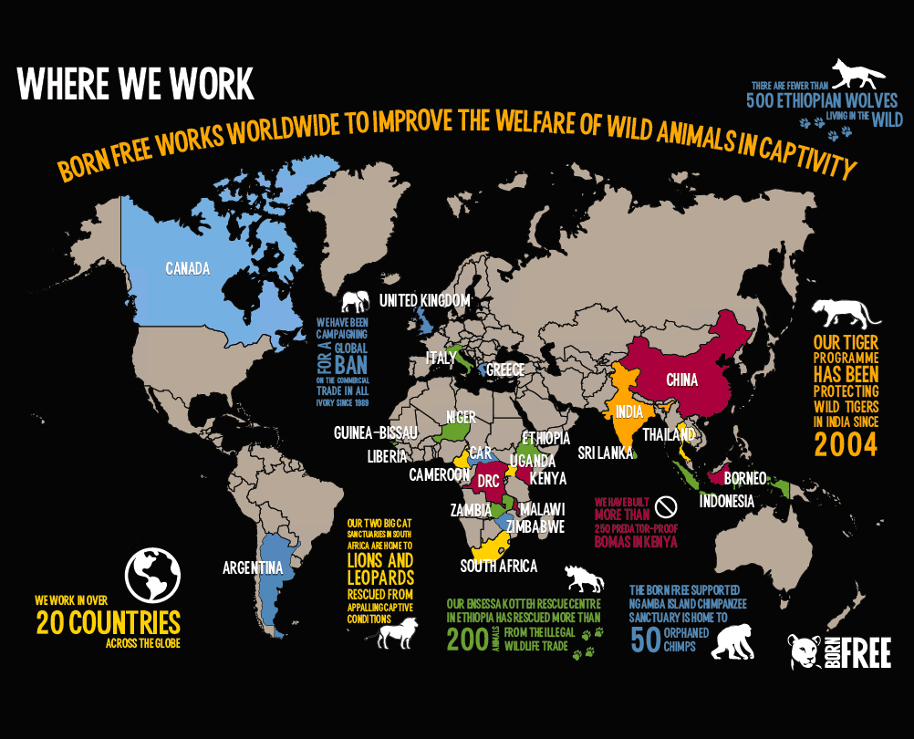

Slide 5
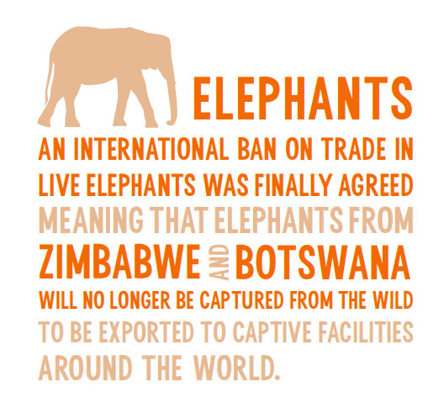
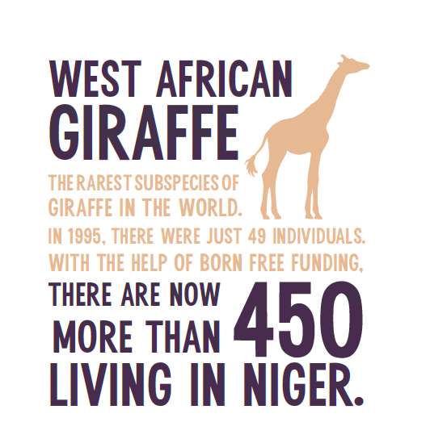
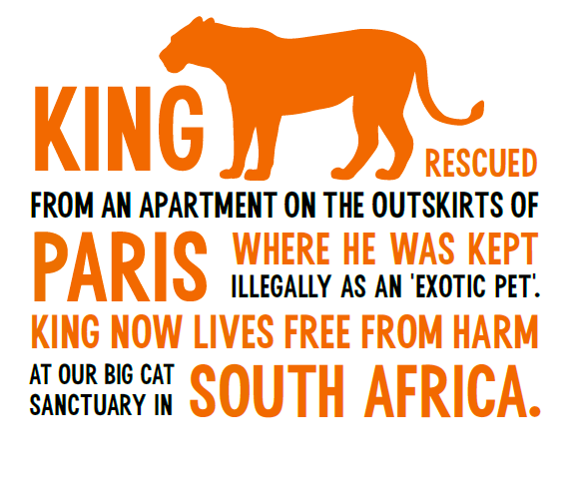
KEY SUCCESSES

Slide 6





WHERE YOUR MONEY GOES
£500
Could enable us to investigate
a zoo in Europe as part of our
Raise the Red Flag programme
£800
Could pay for one month
of care for a rescued lion
at Ensessa Kotteh
£1,000
Could build a travel crate to
transport one rescued young
lion OR two rescued servals
£2,000
Could pay for veterinary care
during the transport of a lion
from a wildlife rescue centre in
Europe to our big cat sanctuary
in South Africa
£5,000
Could buy enough materials
and supplementary food to
provide all 55 of our rescued
primates at Ensessa Kotteh with environmental enrichment for six months
£1,500
Could enable Born Free to publish scientific papers on the private keeping of dangerous wild animals

