Slide 1
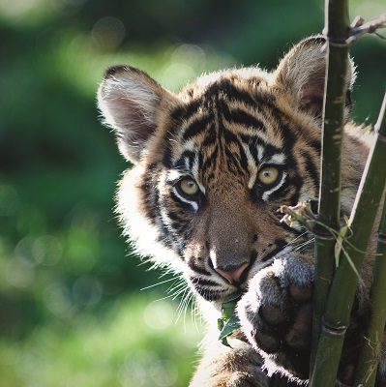



Circuses
Lesson 2. A day in the life of a tiger
Learning objectives
To compare the life of a tiger in the wild with one in a circus.
To write a diary entry entitled ‘A day in the life of a tiger’.
© BFF

Slide 2


What can you remember about tigers?
Habitat Where do tigers live? Can you name countries? Do they like hot or cold weather? | Characteristics What makes tigers special? Can you remember any of their adaptations from the last lesson?
Threats Why do you think that tigers are Endangered? How many tigers are there left in the wild? | Questions What do you want to find out about tigers?
© BFF

Slide 3

What do you already know about tigers?
Your teacher will now read some information about tigers to you.
Listen carefully!
Add any extra information to your sheets in a different colour.

Slide 4
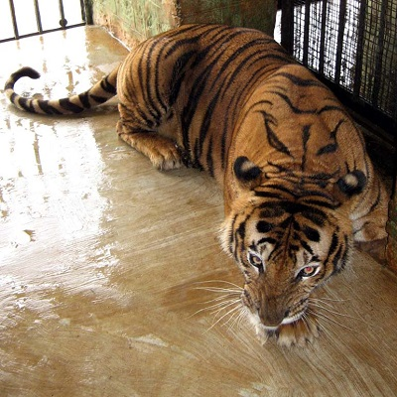
Globally, thousands of wild animals are used in circuses and forced to perform demeaning and unnatural tricks to entertain the public.
Life in the circus is very different to life in the wild.
© BFF

Slide 5
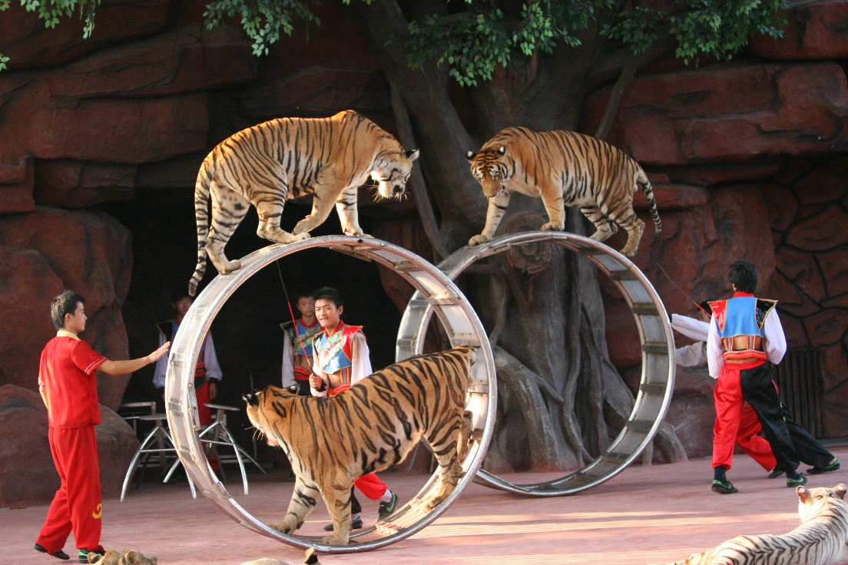
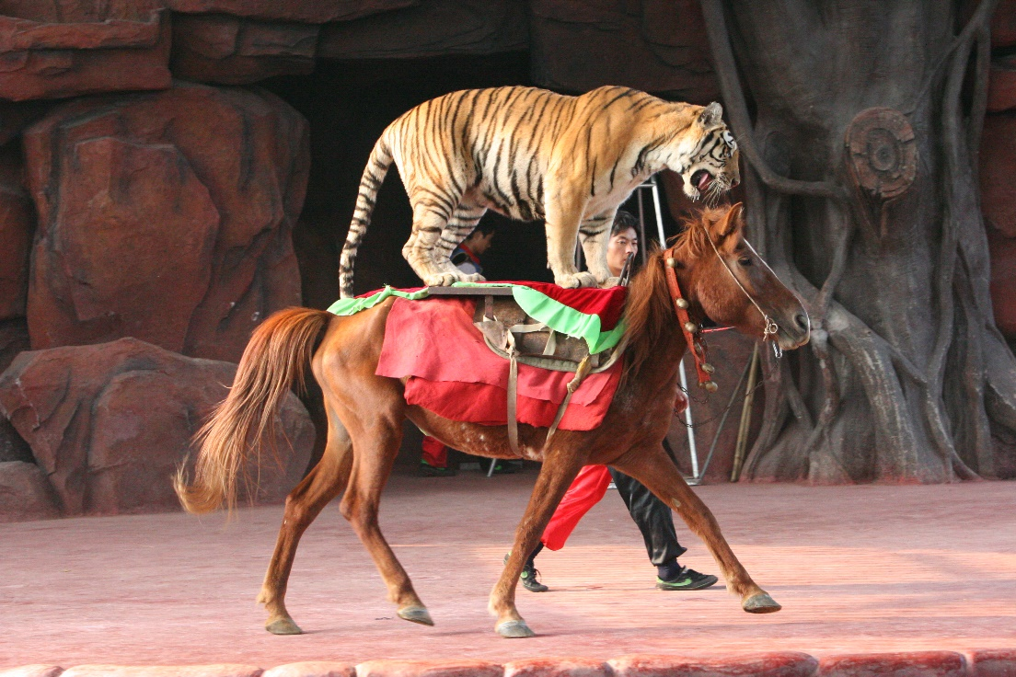
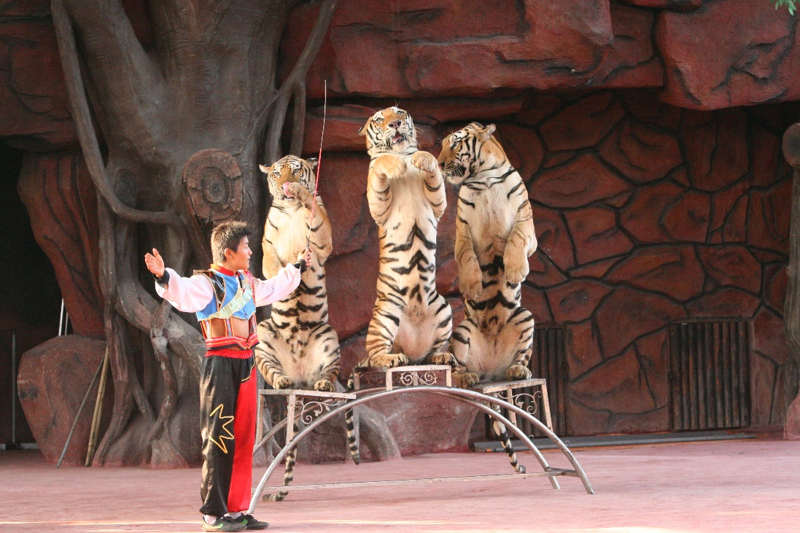
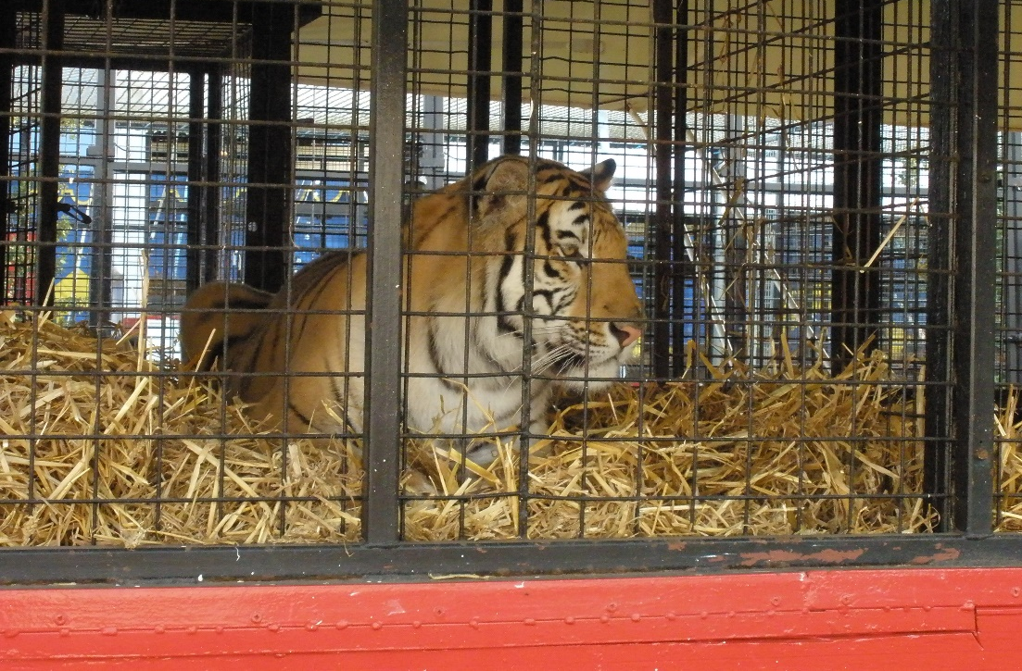
© Animals Asia

Slide 6
The life of a circus tiger
Your teacher has divided you into five groups.
Each group has been given a different feature of a circus tiger’s life.
You have 10 minutes to read, discuss and write down any notes to become an expert.
In your new group, feedback what you have found out.
Now, fill in the blank drawing of a tiger with your information. You could even try making your words look like stripes!

Slide 7


Slide 8
A day in the life of a tiger
Choose either a wild or a circus tiger and write a diary entry about your day.
Include an introduction to set the scene and create atmosphere
Use adventurous vocabulary to describe the places where the events take place
Write in the first person but in the past tense
Use personal pronouns such as I, we, my, me
Talk about important events
Talk about feelings, reaction and opinions from the writers point of view
Use paragraphs to organise the events and write them in chronological order.

Slide 9




Plenary
Head
Something that has made you think
Heart
Something that you have felt
Bin
Something you did not find interesting
Bag
Something you will remember and take away

