Slide 1
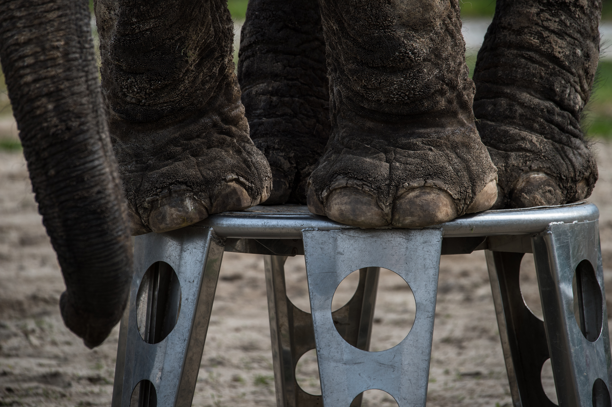



© J McArthur, BFF
Circuses
Lesson 1. Wild animals in the circus
Learning objectives
To describe how different organisms are adapted to their environment.
To explain why organisms succeed best in their own natural environments.

Slide 2





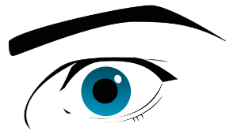
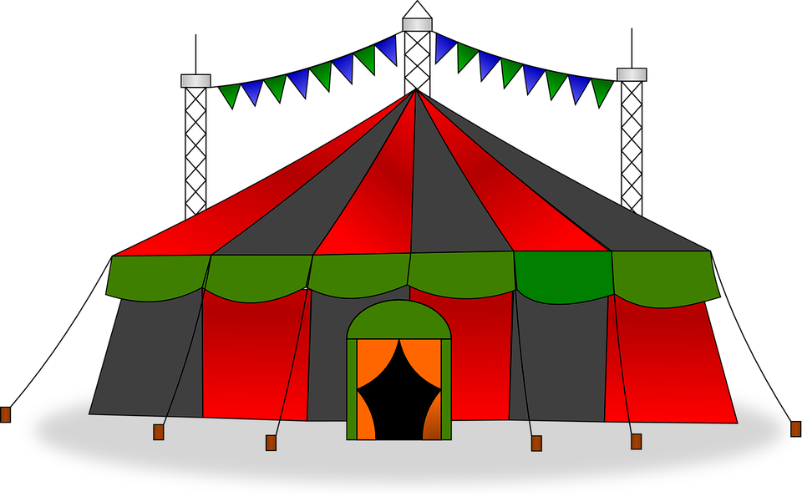

Senses at the circus
Touch
Smell
Hear
Taste
See
Images sourced from Pixaby.com (creative commons)

Slide 3
The circus
How many of your answers involved animals?
Discuss: Would you expect to see animals at the circus?
Circuses can be fun and entertaining places where performers show incredible skill, but are they an appropriate environment for wild animals?

Slide 4
Animal adaptations
What does the term adaptation mean?
Adaptations are special features or behaviours that make a plant or animal particularly suited to its habitat.
A habitat is a place where a plant or animal lives. Examples include the desert, rainforest, woodland or the sea.
Adaptations are a part of the evolutionary process.

Slide 5
Animal adaptations
Each group has been given a picture of an animal.
You need to annotate its adaptations (special features or behaviours) that make it particularly suited to its environment.
After five minutes you will feedback your answers to the class.
Challenge: Can you identify the physical, social and behavioural adaptations?
Notes:
The ICUN (International Union for Conservation of Nature) is the global authority on the status of the natural world and the measures needed to safeguard it. The ICUN status lists species from Least Concern to Extinct. http://www.iucnredlist.org/

Slide 6
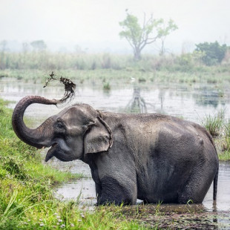
Asian elephant
© BFF
IUCN Status | Population | Diet | Habitat
Endangered | 35,000 ⬇️ | Herbivorous – Grass, leaves, twigs, buds, fruit, roots and bark. | Woodland habitats, from tropical to deciduous forests.

Slide 7
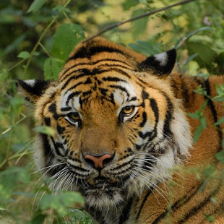
Tiger
© BFF
IUCN Status | Population | Diet | Habitat
Endangered | 4,000 ⬇️ | Carnivorous – They eat lots of different things including wild pigs, deer, water buffalo, rodents, reptiles, birds, fish, and even insects. | Found mainly in the forests of Asia, from the freezing northern forests to hot and humid tropical rainforests.

Slide 8
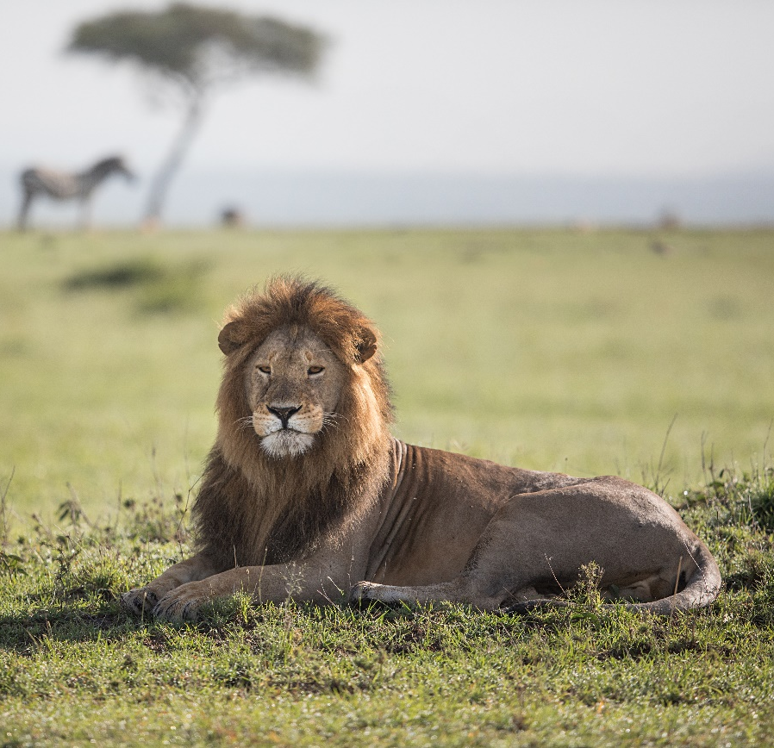
Lion
© George Logan
IUCN Status | Population | Diet | Habitat
Vulnerable - Lions in northern Africa are particularly threatened, with West Africa lions listed as critically endangered. | 20,000 ⬇️ | Carnivorous – Medium and large mammals such as buffalo and zebra. Occasionally they eat giraffe and young elephants. | The are found in lots of different habitats across Africa, but not in tropical rainforest and the Sahara desert.

Slide 9
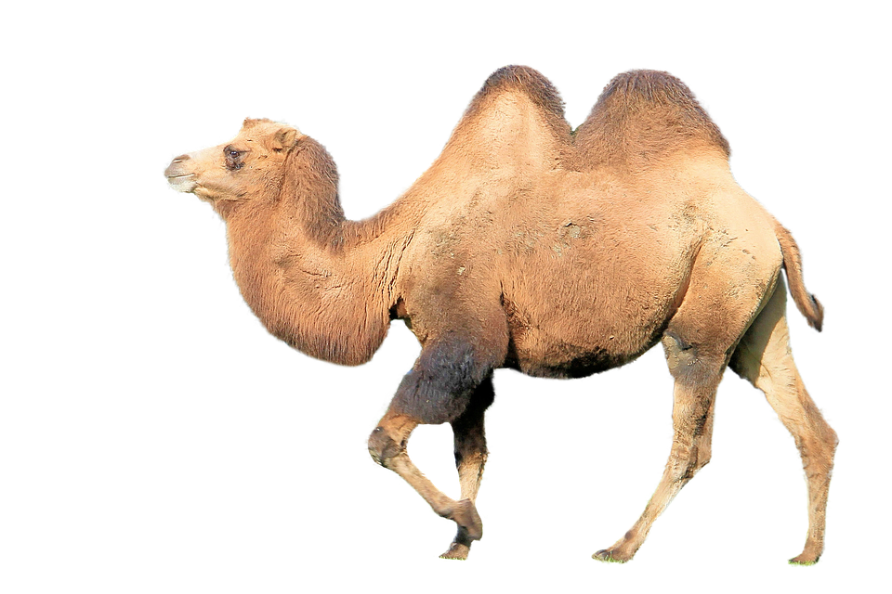
Camel
Image sourced from Pixaby.com (creative commons)
IUCN Status | Population | Diet | Habitat
Least concern | Many millions | Herbivores – In the desert, camels can’t be picky about what they eat. They graze on small plants, bushes and even twigs. | The two types of camel are found in deserts. They can survive in very hot and very cold temperatures.

Slide 10
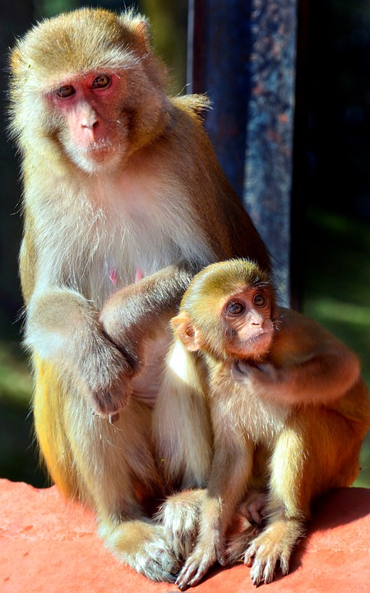
Macaque
Image sourced from Pixaby.com (creative commons)
IUCN Status | Population | Diet | Habitat
Least concern | Unknown | Omnivore - Leaves and pine needles, roots and the occasional insect or other small animals. | They enjoy open areas that are dry. However, they can also live in mountains and woodlands.

Slide 11
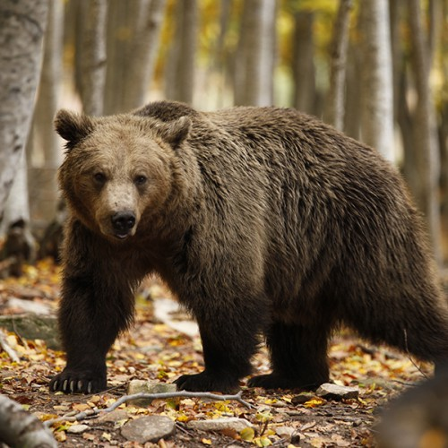
Brown bear
© BFF
IUCN Status | Population | Diet | Habitat
Least concern | Over 200,000 | Omnivore - Berries, fruit, nuts, insects, small mammals, reptiles, fish and honey. | Brown bears live in lots of different habitats, including mountain forests, ice fields and on the edge of deserts.

Slide 12
Animal adaptations
Option 1
Each group has been given a set of animal adaptation cards, cut up and jumbled up in an envelope.
Try and work out which adaptations belong to each animal by grouping the cards together.
Once you have the correct answers, take your favourite adaptations from each animal to create a new species!
Challenge: Can you identify the physical, social and behavioural adaptations?

Slide 13
Animal adaptations
Option 2
You have been given an animal adaptation on a piece of coloured card.
Find the other members of your group with the same colour cards as you and then sit together.
Decide which wild animal you have been given.
Using your cards, create an information poster that can be used to teach the rest of the class about your animal.
You can create one poster as a group or split into smaller groups.
Challenge: Can you identify the physical, social and behavioural adaptations?

Slide 14
African Elephant
Asian elephant
I have a trunk to pick up food, drink water, breathe, and greet my friends. It has over 100,000 muscles in it! | I assist with plant dispersal by depositing undigested plant seeds in my poo!
My large ears help me keep cool and communicate a range of emotions. | I can uproot trees and dig for water in the dry season.
I have two tusks which are used to peel bark off trees, ‘mine’ for minerals and defend against predators. | My skin is up to 3cm thick and my wrinkles help to retain moisture.
© BFF

Slide 15
Tiger
My distinctive markings blend in to the colours and shadows of my habitat. I have a reddish-orange coat with a white belly and black stripes. | I use scent to communicate. I spray urine and rub scent on trees and bushes to inform other cats of my whereabouts!
I am able to expand my throat. This allows me to swallow food in large pieces or even whole. | I have an incredible sense of hearing and my roar can be heard as far as three kilometres away!
I normally hunt alone but I am awesome at it! I have retractable claws, powerful jaws, sharp teeth and acute senses. | I have soft pads on my feet that allow me to walk on my toes and sneak up on unsuspecting prey.
© BFF

Slide 16
Lion
Lion
I hunt in groups so that we can surround and overpower large prey. | I have a highly developed part of my brain called the cortex. This is the part of the brain that deals with decision making, problem solving and social behaviour
I am an excellent hunter with a very powerful body and brilliant senses. | My roar is used to communicate with other pride members and to warn off intruders.
My large, sharp claws help me catch prey. They can also be used for defence and to display strength to other animals. | My tan colour fur helps me to blend into the grassland habitat where I live.
© George Logan

Slide 17
Camel
Camel
I have very long eyelashes. This helps keep sand out of my eyes. | I store fat in my hump so I can survive when there are long periods without food and water. I can go over a week without water!
I can close my nostrils so that sand doesn’t get up my nose. | I have wide feet with leathery pads on the bottom. This acts a bit like a snowshoe and stops me sinking into the sand.
The colour of my fur helps me blend in with the sandy desert. | I have big, thick and tough lips that enable me to pick at dry and thorny vegetation.
Image sourced from Pixaby.com (creative commons)

Slide 18
Camel
Macaque
My arms are very long compared to my legs. I use these long arms to climb and swing on branches. | I have opposable thumbs (just like humans). This allows me to climb and groom others.
I have lots of expressions and noises for communication. I use a variety of grunts, squeaks, screams and barks to express my emotions. | I have a tail that I use for balance when climbing.
I build my nests on tree tops. I use twigs, leaves and branches of trees and sleep inside the nest throughout the night so that predators can’t see me. | I have a large brain compared to my small size. This means that I am very clever!
Image sourced from Pixaby.com (creative commons)

Slide 19
Camel
Brown bear
I have long claws that are not retractable. I mostly used them for digging and to catch food such as salmon. | My thick fur and layer of fat keeps me warm during the extremely cold winters.
I have a fantastic sense of smell. I stand on my hind legs so I can that smell, see and hear better. | I don’t fully hibernate but I do go into a deep winter sleep for 5-6 months. I sometimes go for more than 100 days without eating or drinking!
Underneath my thick fur are large muscles that give me a hump on my neck and shoulders. These muscles help me be a powerful hunter. | Our baby cubs are born hairless and blind! They stay with their mother until they are 2 to 3 years old.
© BFF

Slide 20
Reflect
Do think the circus is different to an animal’s natural habitat?
Think
Pair
Share

