Slide 1
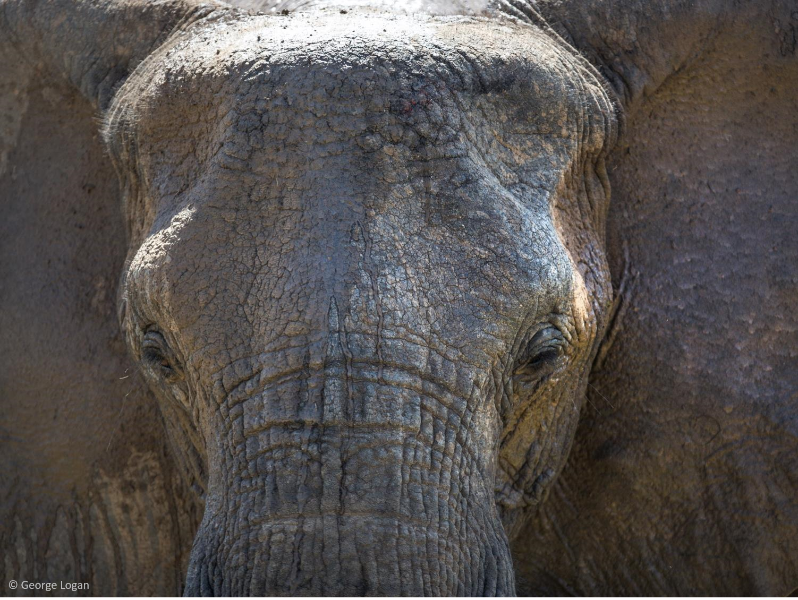



Elephants in Crisis
Lesson 2: Threats
Learning objectives:
To explain why ivory is in demand.
To explain the causes and effects of the international trade in illegal ivory.
To begin to identify solutions to the illegal trade in ivory.

Slide 2




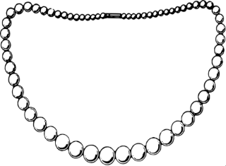
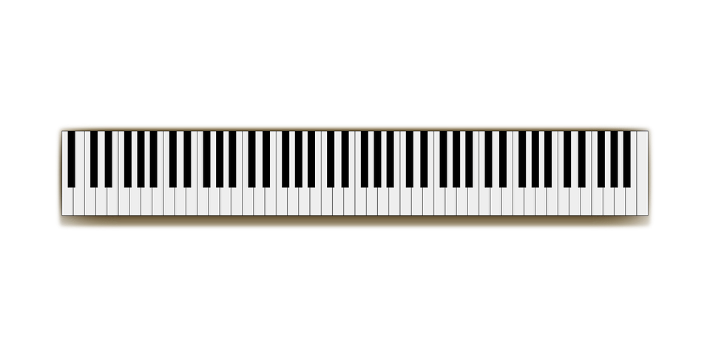



What do all these items have in common?
Which have you had a chance to see and feel close up?
What other materials can be and have been used for these objects?
Images sourced from Pixaby.com (creative commons)

Slide 3
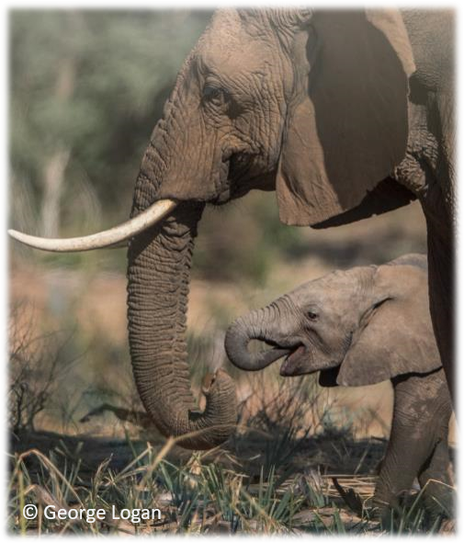
Ivory
What is ivory?
Ivory is a hard, white material that some animals' teeth and tusks are made from – including elephants, hippopotamuses and some whales.
In the 19th century, ivory from elephants became a popular and fashionable product. It was used to make many things, including jewellery, combs and piano keys.

Slide 4
Ivory
5m 500,000
20,000 a year
55 a day
One every 25 minutes
Notes:
In the 19th century, ivory from elephants became a popular and fashionable product. It was used to make many things, including jewellery, combs and piano keys.
This desire for ivory led to millions of elephants being killed for their tusks.
A century ago, there were maybe 5 million elephants across Africa. Now there are less than 500,000.
Around 20,000 African elephants are being killed every year for their ivory - that's around 55 everyday, or one every 25 minutes

Slide 5

The ivory trade
Elephants are still being killed in their thousands for Bloody Ivory. Illegal ivory is still being smuggled out of Africa. We must stop this happening and support improved protection for elephants.
Notes:
https://vimeo.com/280547403

Slide 6
The ivory trade
CITES banned the unrestricted international commercial trade in ‘new’ ivory in 1989.
However, as it currently stands in the UK, there are some exemptions for trading in carved antique ivory. Ivory pieces carved after 1947 date but before the international ban came into force are also exempt if accompanied by a government-issued certificate. Through this market, certain antique ivory products can therefore be legally bought and sold domestically and can be legally re-exported internationally with relevant CITES permits.
The USA introduced a near-total ban on elephant ivory sales in 2016 and China followed suit towards the end of 2017, leaving the UK world’s largest global exporter of legal ivory.
The commercial trade in both old and ‘new’ ivory stimulates demand, compromises law enforcement, and provides a potential means by which ‘new’ ivory from poached elephants can be laundered into trade.
The illegal wildlife trade is recognised as the fourth biggest organised criminal activity on the planet, and is estimated to be worth up to £17 billion a year. The greatest flows of illegal ivory move by sea and air from Africa to Asia, with Hong Kong and China as the largest consumer markets.

Slide 7
The ivory trade
The international trade in illegal ivory is long and complex. It crosses borders and oceans and travels from the remotest corners of Africa thousands of miles to retail markets in Asia.
Tasks:
Cut out the cards and sort them into categories.
How did you categorise the cards? Why?
What are the causes of the illegal ivory trade?
What are the effects of this trade?
What are the background factors involved?
Challenge: What are the trigger factors that have lead to consequences?
Create a storyboard to explain how the illegal ivory trade works

Slide 8
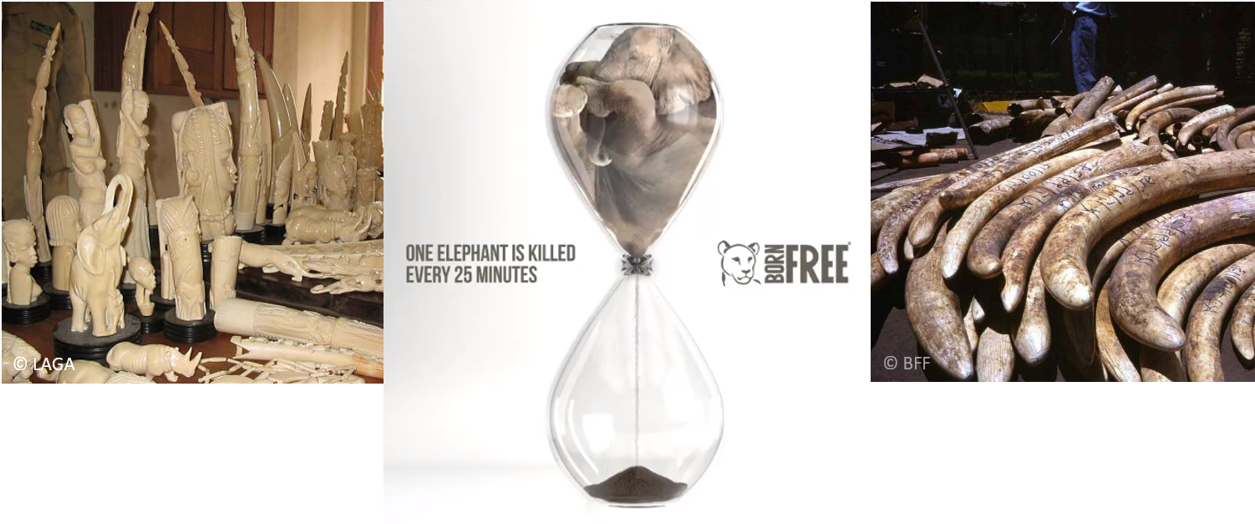
Review
What can you do about the illegal ivory trade?
Suggest 3 ways this issue could be tackled.

Slide 9
What can you do?
Fundraising
There are lots of ways for you to get involved and fundraise for Born Free. For example hold your own ‘Go Wild’ event or activity – big or small - and every single penny you raise will help Born Free care for and protect animals.
To help with fundraising, we have created a number of fundraising posters that you can choose from to help promote your event.
Visit https://www.bornfree.org.uk/fundraising for more information
Sign the petition https://www.bornfree.org.uk/ivory-trade-petition
Spread the word: Share on Facebook, Share on twitter
Donate https://www.bornfree.org.uk/donate
Join Wild Crew https://www.bornfree.org.uk/kids-club

