Slide 1
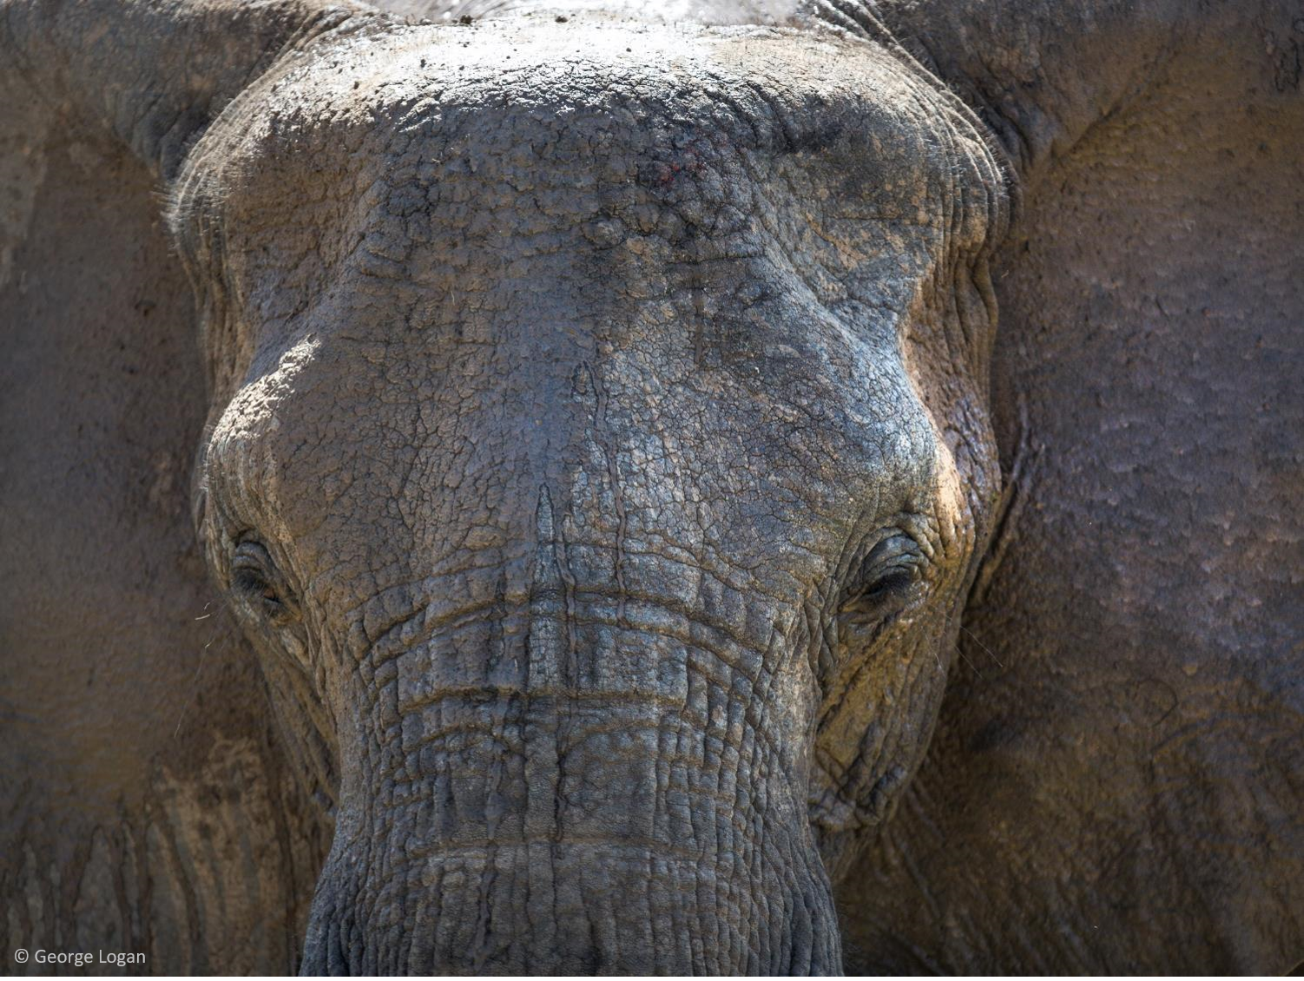



Elephants in Crisis
Lesson 1. Incredible elephants
Learning objectives
To share knowledge of elephants.
To understand how elephants and humans share similar characteristics.
To create a poem entitled ‘Incredible Elephants’.

Slide 2


Incredible elephants
Post-it challenge
On post-it notes, write down as many words as you can that you associate with elephants. Try and cover the whole table.
5 minutes
Use at least 10 of these words to write a short paragraph about elephants.
Feedback to the class.
majestic

Slide 3
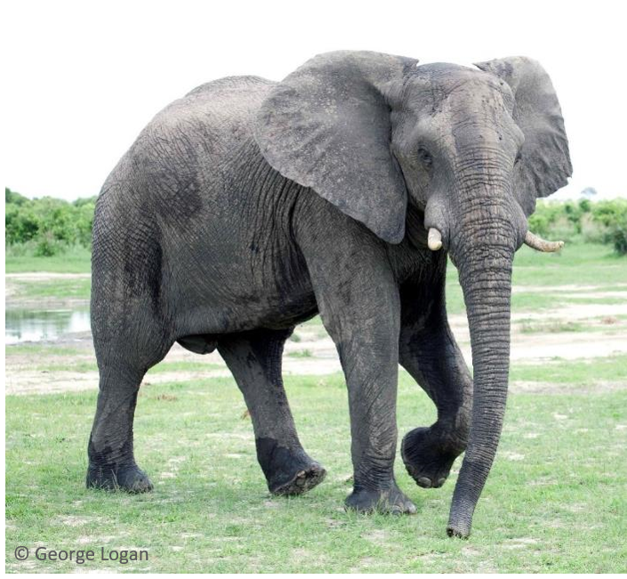
Incredible elephants
Around the image, write down as many words as you can that you associate with elephants.
Use at least 10 of these words to write a short paragraph about elephants.

Slide 4


How big is an elephant?
How tall is an elephant?
How long is an elephant?

Slide 5
What do you know about elephants?
What are the three distinct species of elephant?
Asian, African savannah and African forest
European, African savannah and African
Asian and African savannah and Australian forest
Both species of African elephants have larger ears shaped like a map of Africa whereas Asian elephants have smaller ears like the shape of India.

Slide 6
What do you know about elephants?
2. How long can elephants live for?
40-50 years
50-60 years
60-70 years
The average life expectancy for humans across the world is 72.

Slide 7
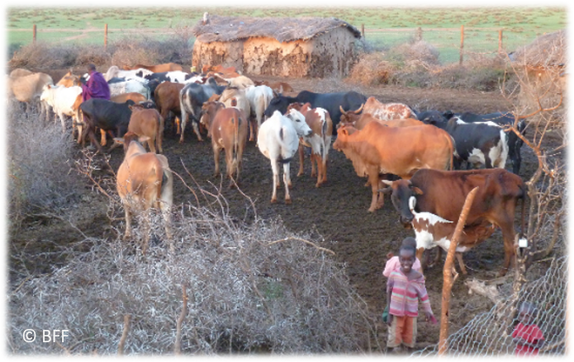
What do you know about elephants?
3. The African savannah elephant is the largest and heaviest land animal on Earth, but how much can one weigh?
60kg
6,000kg
60,000kg
That’s about nine times
as heavy as a cow!
© BFF

Slide 8
What do you know about elephants?
4. How fast can an elephant charge?
10mph
25mph
40mph
An Olympic sprinter can reach a top speed of 27mph.

Slide 9
What do you know about elephants?
5. Elephants have the longest gestation period of all mammals, but for how many months do elephants carry their babies before giving birth?
9 months
15 months
22 months
That’s almost 2 years!

Slide 10
What do you know about elephants?
6. What is a female elephant called?
A cow
A bull
An elephantess
A male elephant is called a bull.

Slide 11
What do you know about elephants?
7. How many muscles are there in an elephants trunk?
100
10,000
100,000
The entire human body only has around 650 to 840 muscles!

Slide 12
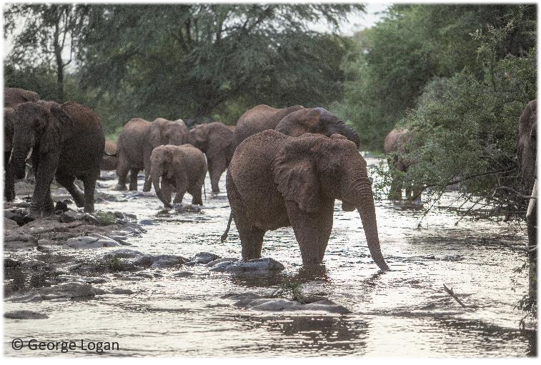
What do you know about elephants?
8. How much water does an adult elephant need to drink every day?
2 litres
20 litres
200 litres
That’s nearly 3 baths
full of water!

Slide 13
What do you know about elephants?
9. Can elephants swim?
Yes
No
They use their trunk to breathe like a snorkel in deep water!

Slide 14
What do you know about elephants?
10. Can elephants get sunburnt?
Yes
No
They protect themselves by throwing sand on their backs and their head.

Slide 15
Elephants are just like us
How do you think your life might be similar to an elephants?
Elephants live in close-knit family groups, caring for and protecting their young.
They support, care and comfort each other, when friends or family members are in distress.
They love to play and interact with each other.
Just like humans, they celebrate births and they mourn the loss of their family members.

Slide 16

Elephants are just like us
Notes:
https://www.youtube.com/watch?v=ciVsS-oZEPc

Slide 17
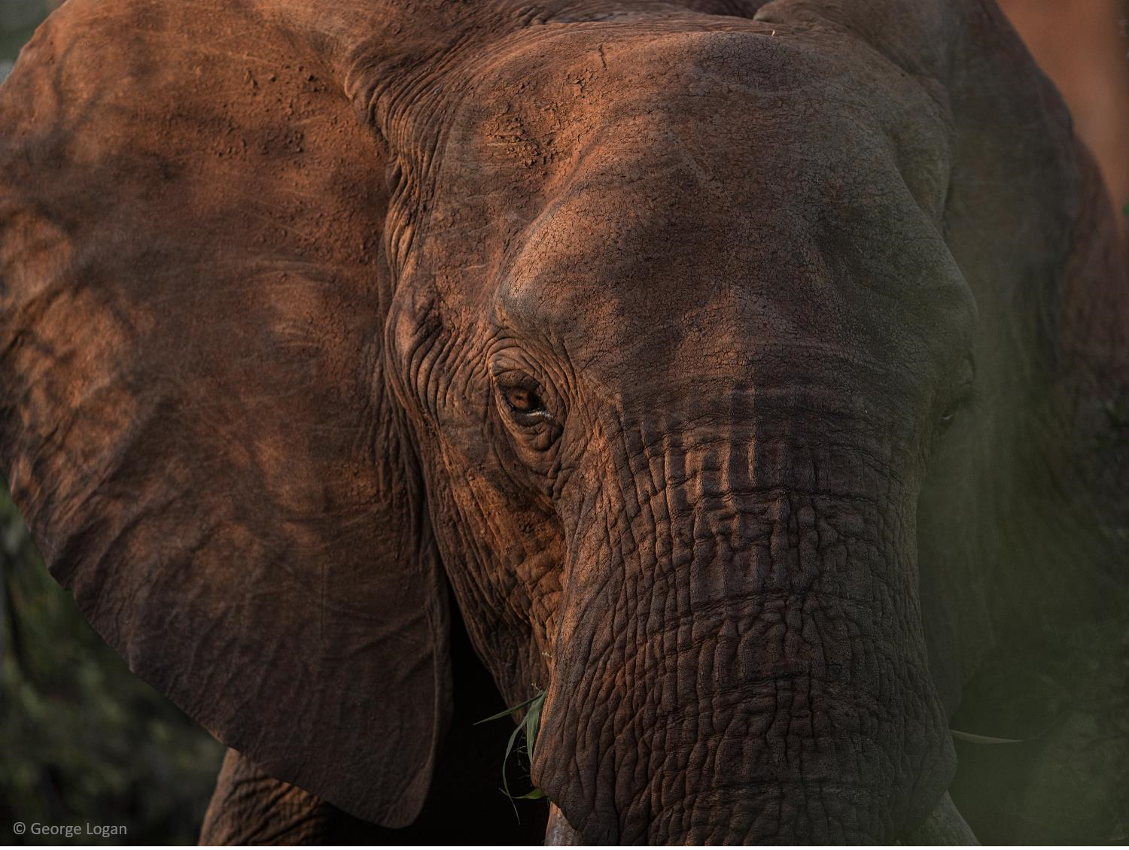
Elephant poems
Choose one of the following tasks:
Task 1 Write a poem with the title, ‘Incredible Elephants’. Use your post-it notes, the images of elephants and any other information you have learned today. Identify your audience and think about the purpose of the writing. | Task 2 Your teacher has cut up some poems about elephants and has put them into an envelope. Create a new poem by arranging them into a different order. Try to add your own words or lines. Identify your audience and think about the purpose of the writing.

Slide 18
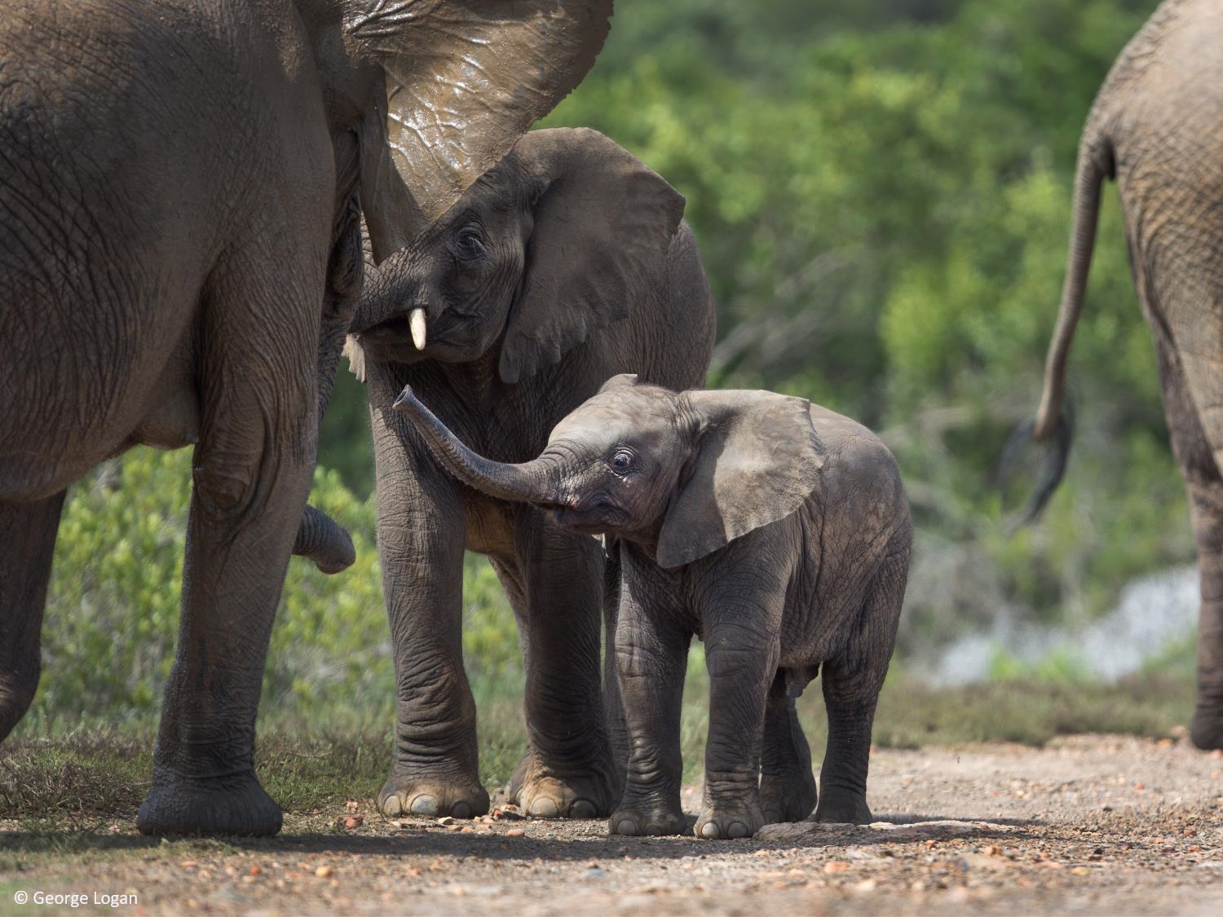
Review: What have you found out today?
Tell me 3 things...
You know now that you didn’t know an hour ago
You have done well
You would like to find out more about

